Slide 1
ST2 - Viral Propagation - EI DEX
by the Ponzi Scheme Team : Thomas CHAUBIN, Adam DEBBAH, Bao LUGHERINI , Adrien TESTON, Amine LECHHEB

Slide 2
Overview:
I. Context: Defining the Goal and the constraints
II. Simulation: Assessing Our Solution
III. Solutions and Areas for Improvement
What are we trying to achieve?
How will we evaluate the effectiveness of our proposed solution?
Detailing our approach and potential refinements.

Slide 3
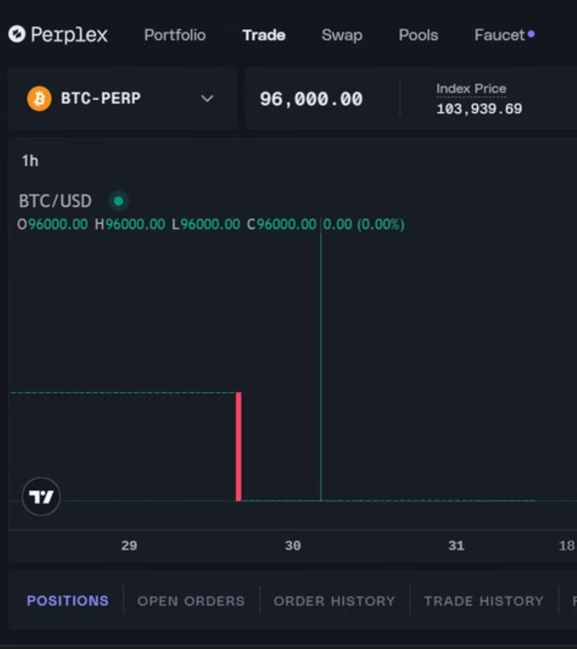
Context : Mitigating Contagion and Herding on Crypto Trading Platforms (Perplex)
We analyze the problem, examine existing approaches, and propose a novel solution.

Slide 4


The Contagion and Herding Challenge
Rapid Contagion
Herding Behavior
Fast spread of market sentiment, trading activity across platforms → Amplified price fluctuations.
→ Concentrated trading patterns and increased volatility.
Can create bubbles and exacerbate crashes.
Can be triggered by external events, news, or even rumors.

Slide 5
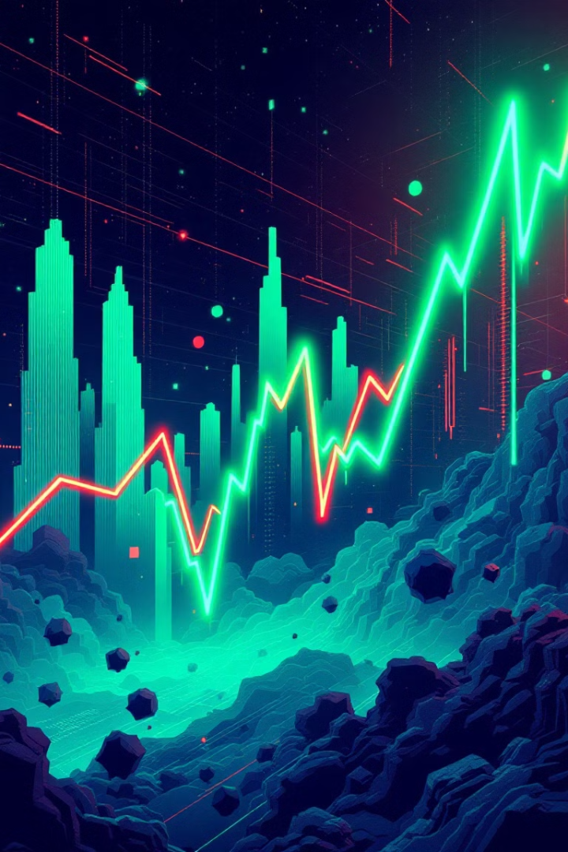
Our approach to the problem
1
Simulate a Crypto Market
2
Study propagation on the market
With specific traders (Market Makers, etc.)
Like massive liquidation cascade
3
Mitigating
Objective : mitigate and limit the spread of liquidation

Slide 6


Cryptocurency Market Simulator
Specific Traders
Auto Liquidation
Market Makers
Automatically liquidates the trader when his loss exceeds a certain threshold.
Degen Traders
Swing Traders
Square Root Law of Price Impact
Delta P is the impact on price, alpha is the volatility of the asset, V is the volume traded, L is the Liquidation Volume.

Slide 7
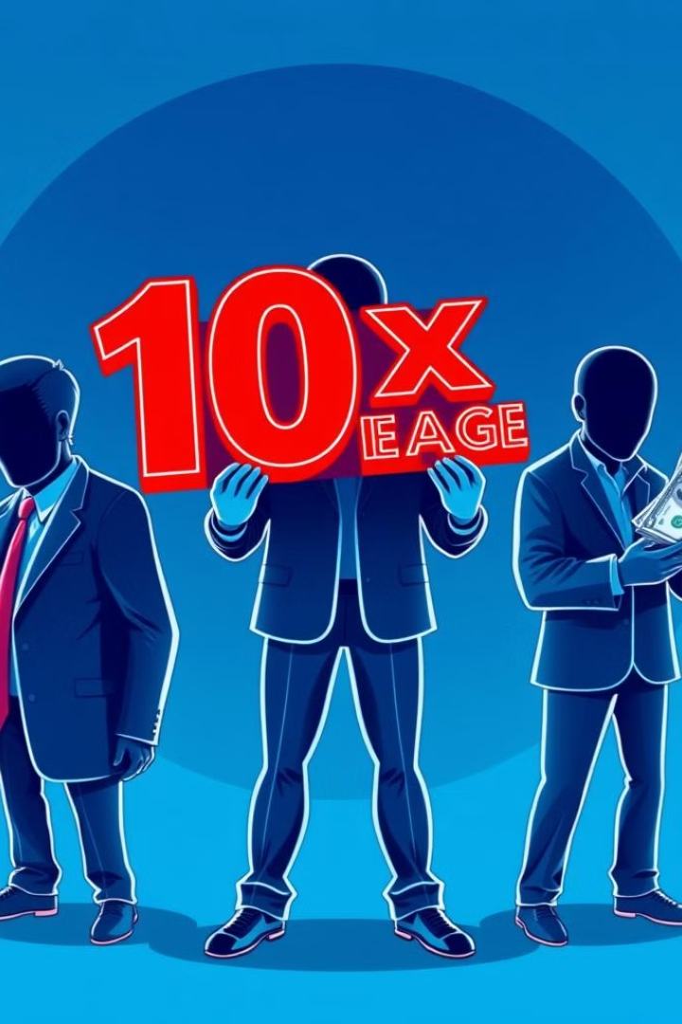
Specific Traders Features
Market Makers: Low apetite for risk
High trading frequency, provides liquidity
Low Herd probability
Degenerate Traders: High-risk traders, aggressive positions
Higher Leverage
Less Trading but Panic Sells
High Herd probability
Swing Traders: Opportunists
Medium Leverage
Trades frequently : Buys if Bullish Market, Sells if Bearish Market
Medium Herd Probability

Slide 8
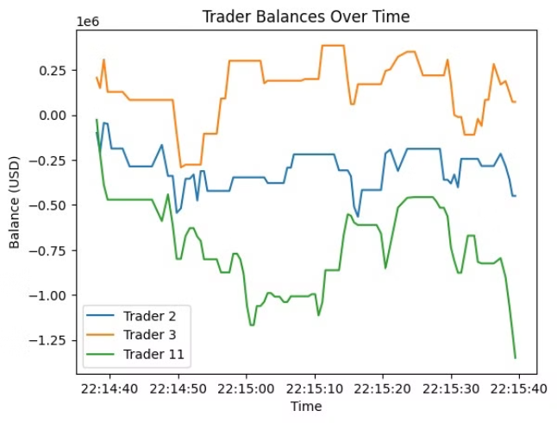
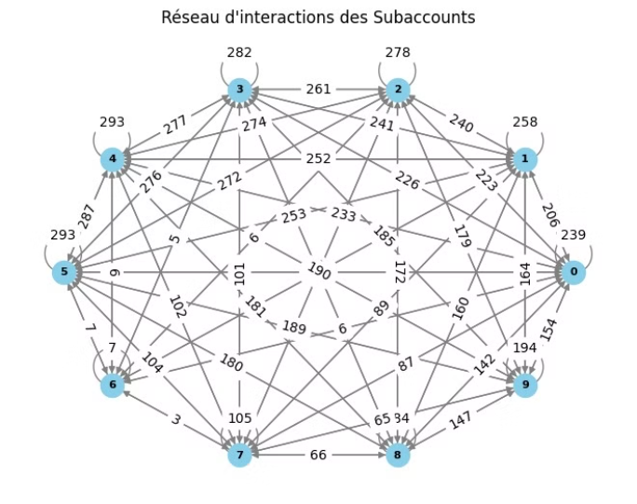
Simulated Market : a small test
Non Liquidated Trader Balances Over Time
Trader balances react differently: Trader 3 remains stable, while Trader 2 fluctuates a lot and Trader 11 suffers heavy losses.
10 Traders Correlated Actions
6 Market Makers : trade a lot, high correlation
2 Degenerates : trade less, might get liquidated
2 Swing Traders : often trade simultaneously

Slide 9
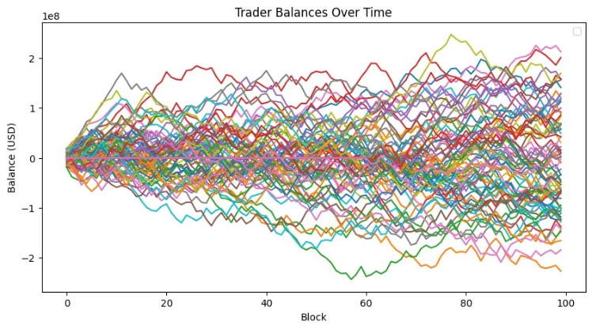
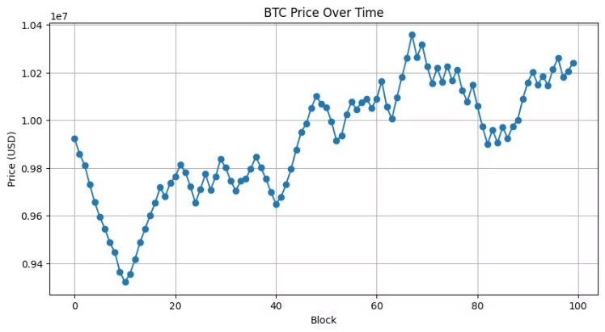
Simulated Market : a larger market
Non Liquidated Trader Balances Over Time
BTC Price Over Time
We observe a normal distribution with a tendency of the mass to get richer as the market prices go up, and poorer when it goes down.
The BTC price graph shows high volatility with sharp rises and drops.
This suggests varied trading strategies, with some traders handling volatility better than others.

Slide 10
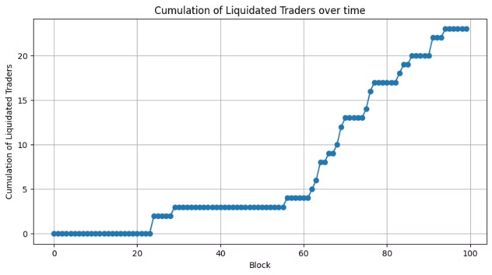

Liquidation on the market with the late introduction of degenerates
70 market makers and 10 swings traders are introduced : few liquidated traders
20 degenerates are introduced at step 60 : observation of a liquidation cascade

Slide 11
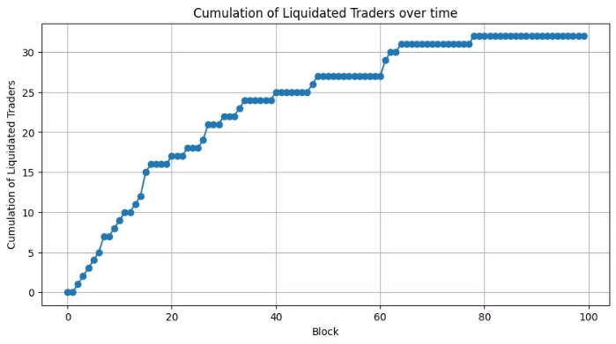
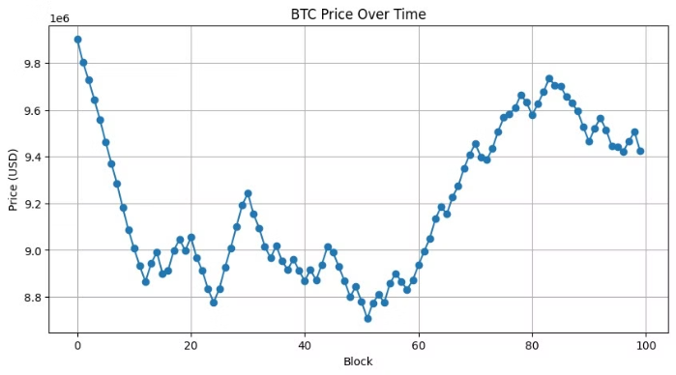
Liquidation on the market with the late introduction of market makers
The number of liquidated traders rises sharply at the beginning, indicating a cascade of forced liquidations due to BTC price volatility. Traders who follow the crowd and trade in risky ways lead to great market instability.
However, the market volatility stabilises and starts decreasing when market makers are added the market.

Slide 12



Our Proposed Solution:
Give Out Free Risk Management Formations
Introduction Of Low Risk Apetite Traders
Educate clients on risk management :
The introduction of Market Makers, Swing Traders dilute Degenerates' influence.
Use a leverage adapted to its wallet
Place limit orders to prevent liquidation
Reduces the Cascade Liquidation effect, or even stops it.

Slide 13
Validation and Testing
Backtesting
1
Analyze historical market data (alpha, volatility,…)
Simulation Testing
2
Simulate various market scenarios and contagion events
Pilot Implementation
3
Deploy the solution in a controlled environment (managed by parameters)

Slide 14



Model Implementation : areas for improvement
Machine Learning Models
1
AI algorithms to analyze trading data and to optimize market indicators to optimize parameters (alpha, volatility,…)
Global market's dependencies
2
Introduce the dependence of other cryptocurrencies, of events
Introduce realistics sets of trader profiles
3
Collect more comprehensive data on the market

Slide 15
Thanks for your attention !

Slide 16
Bibliography
https://www.sciencedirect.com/science/article/pii/S2405918825000030
https://hal.science/hal-03668669v1/file/Market_Impact_Empirical_Evidence_Theory_and_Practice.pdf
https://www.sciencedirect.com/science/article/pii/S0960077919300669

